Slide 1
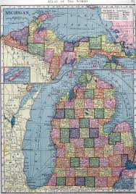
Exploring Michigan
By Nettie Foster

Slide 2
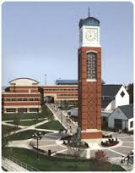
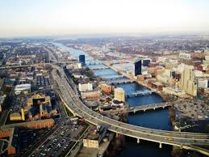
Grand Rapids
To visit my brother at Grand Valley and shop for a prom dress

Slide 3
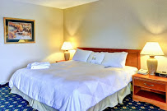
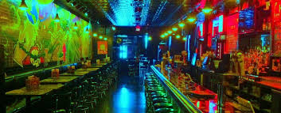
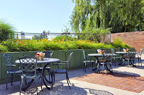
Food and Activities:
Family ate at Stella’s Lounge downtown=$56.14
Stayed at Riverfront Hotel for $94
Gas round trip was $18.25
Paid $215 for prom dress

Slide 4
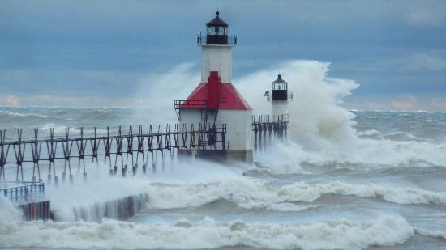
St. Joseph
To tour light houses with my friend, Christina

Slide 5
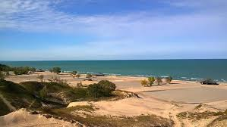
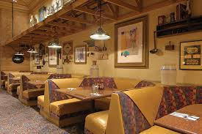
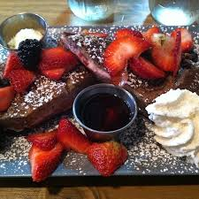
Food and Activities:
Lighthouse tour=$24
Stayed at Warren Dunes State Park=$27
Ate dinner at Silver Beach Pizza for $17.49
Breakfast at Joe’s Café Breakfast House $24.35

Slide 6
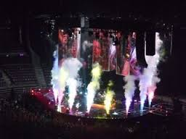
Auburn Hills
To see a Maroon5 concert at the Palace

Slide 7
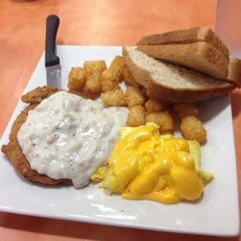
Food and Activities:
Tickets to concert=$74.17
Merchandise =$37
Buffalo Wild Wings =$12.48
Stayed at the Hilton which was $170 for a night
Breakfast at Toasted Bun=$7.99
Gas =$27.38

Slide 8
Money Data:
City Location | Gas | Food | Hotel | Other
Grand Rapids | $18.25 | $56.14 | $94.00 | $215.00
St. Joesph | $29.01 | $44.49 | $27.00 | $24.00
Auburn Hills | $27.38 | $20.47 | $170.00 | $111.17
Total | $74.64 | $121.10 | $291.00 | $350.17 | $836.91

