Slide 1
CPR/AED - Allied Health
Keannlay

Slide 2
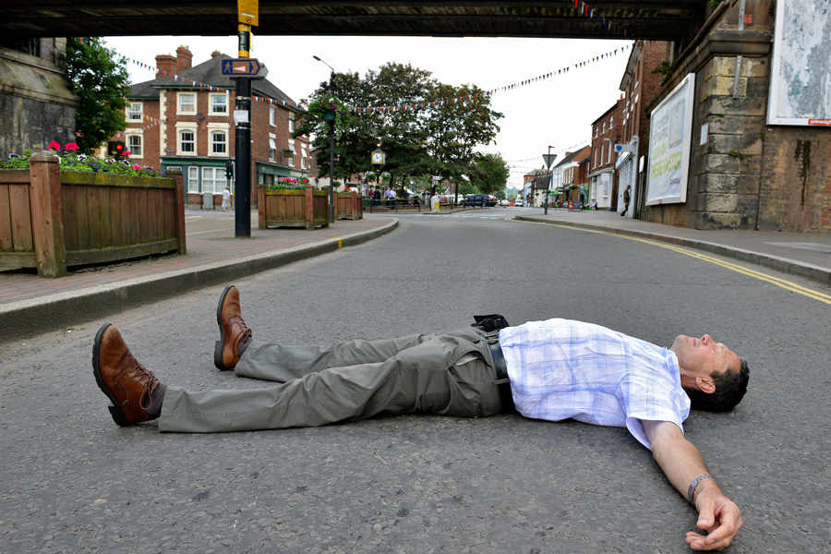
HOW TO APPROACH ANY SITUATION
Make sure the scene is safe before you decide to proceed further into the incident. If there is anything that could harm you or potentially injure the person more, move it before assisting the situation. If the scene is clear and the person is in a dangerous area, for an example the middle of the road, then move the person to a safe location.
Notes:
When someone needs help, a lot of people just want to go and help, but you need to be safe so you can actually help the other person. If you do not check your surroundings first, you might be calling for help for both of you.

Slide 3
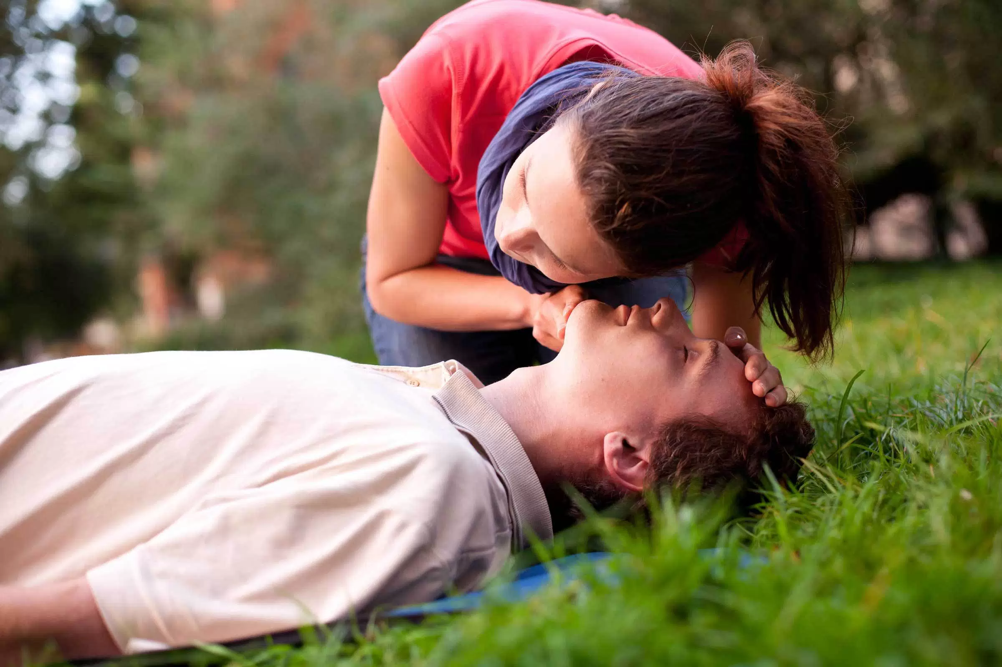
CHECK FOR RESPONSIVENESS
WHAT IS CONSIDERED RESPONSIVE?
Someone who is breathing, coughing, or moving
Tap and shout at the person, “are you okay? Are you okay?”
If not responsive yell for help, “help! Help!”
If there are many people around, point at someone and tell them to phone 911. Tell another one to get a first aid kit and AED
If you are alone call 911 and put your phone on speaker mode
Notes:
It is important to check if the person is responsive because it will tell you what you have to do next. If someone is not responsive, assume they want help. This is one of the major keys to performing CPR.

Slide 4
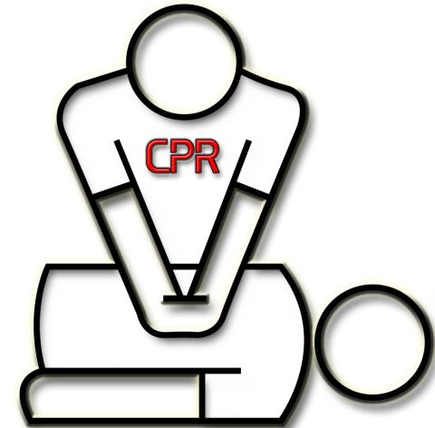
CPR F O R ADULTS
Step 1 - Check for signs of breathing
*If person is breathing do not perform CPR
Step 2 - Start 30 compressions in the middle of the chest
*Depth of pushes with both hands should at least be 2 inches at a rate of at least 100 compressions/minute
Step 3 - Tilt the head back, pinch the nose, and give 2 breaths
*Breaths must be at least 1 second long and you should be able to see the chest rise
Step 4 - Continue CPR until given an AED or professionals arrive *If others (that know how to do CPR) are available, switch each person after 5 cycles
Notes:
If you know how to give someone CPR you could potentially save a life. It is common for someone to have broken ribs, or other injuries after having CPR done to them. Even though they might have broken bones from the result of it, at least they’re alive.

Slide 5
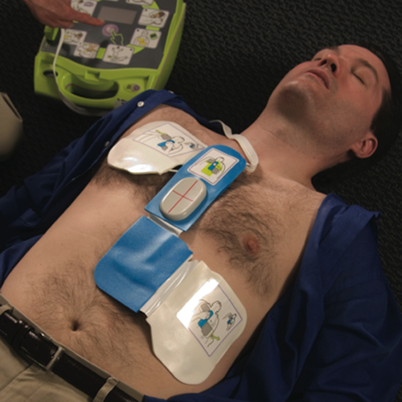
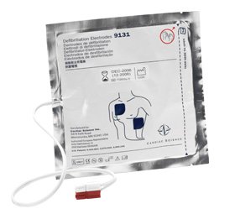
Adult AED
Step 1 - Turn on AED
*Follow voice directions
Step 2 - Bare the chest and take off any medication patches
*Also make sure the chest is dry
Step 3 - Put pads on body
*Make an L shape
Step 4 - Plug in connector
Step 5 - Stand clear
*Advise everyone not to touch the body including yourself
Step 6 - Hit the “analyze” button and let the AED analyze the heart rhythm
Step 7 - Say, “stand clear,” and deliver shock
Step 8 - Continue CPR
Notes:
The AED will help the unresponsive person have a greater chance of survival. It sends a shock to the victim’s heart in attempt to get it to start beating correctly, and or again. They can be located just about anywhere, but CPR alone can also save lives.

Slide 6
CPR FOR CHILD
Step 1: Check for breathing
*Check over body for 5-10 seconds before beginning CPR (if child is not breathing)
Step 2: Start 30 compressions
*Depth should be the same as an adult and depending on size/age of child use one hand instead of both
Step 3: Chin and head back, proceed giving 2 breaths
*Child’s chest should rise just like an adult and breaths should at least be 1 second
Step 4: Repeat and never give up, keep going
*If you’re alone, after about 2 minutes of continuous CPR, leave the child and go get help; call 911
Notes:
You could save the life of your own child, a friend, or just any kid. A child is considered to be around ages 1-8, and depending on their size determines the use of one or two hands. If the child is obviously bigger and larg

Slide 7
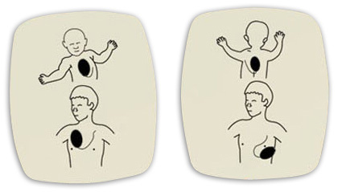
AED For Child
If there are no child pads available, use adult pads
Make sure the pads do not touch though
You should repeat the same steps as using an AED on an adult.
Notes:
Most children’s hearts stop because of respiratory issue or shock. Their hearts become chaotic from VFib and causes them to become unresponsive. With the use of an AED it can help save a child’s life. Unfortunately if untreated it could result in the child dying.

Slide 8
CPR
FOR
INFANT
STEP 1: Make sure if the baby is responsive
*Hit the bottom of its foot and shout, “baby! Baby!” Or the baby’s name
Step 2: Follow the same process as the previous slide, get help, and call 911
Step 3: Begin CPR
*Baby should be on its back on a firm surface
Step 4: Give 30 compressions
*Use two fingers on the breastbone of the infant
Step 5: Give 2 breaths
*Covers infant’s nose and mouth with your own mouth/mask
Step 6: Use AED and follow commands
Step 7: Continue CPR for at most 5 minutes if you have no phone or no one is around
*After 5 minutes of CPR, take the baby with you and get help
Step 8: If already contacted 911, continue CPR until they arrive
Notes:
By giving a baby CPR it can get their heart pumping blood again. Chest compression at a depth of about 1½ are alone effective enough to bring the baby back to life.

Slide 9
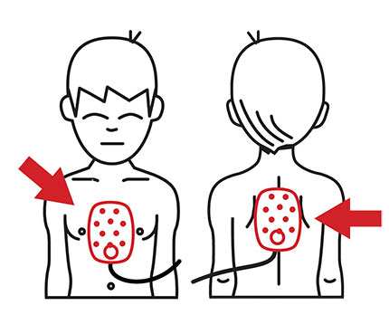
AED - Infants
Step 1: Turn on AED
Step 2: Follow visual or voice prompts
Step 3: Apply pads
*Use smallest pads for infant, if there is not any then use adult ones
Step 4: Let the AED analyze the baby’s heart rhythm and deliver the shock
*Make sure you and no one else is touch the body, “stay clear!”
Step 5: Continue CPR and leave pads on infant
Step 6: Keep going until baby becomes responsive or help arrives
Notes:
Even though for their size, AED are not really recommended on being used on an infant. The helpfulness and the potential bad effects on them are 50/50.

